Slide 1
Phising Awareness
Recognizing and Avoiding Phisisng Attacks
Presented by:
Kavana.B
CSE 5th sem
Rajeev institute of technology

Slide 2
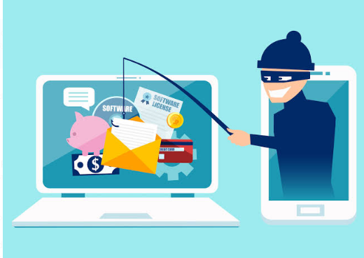
What is phising
Definition:
Phising is a cyber attackers attempt to decevie individuals into providing sensitive information.
Eg: password, credit card number.
Common techniques:
Email spoofing, fake websites, social engineering.

Slide 3
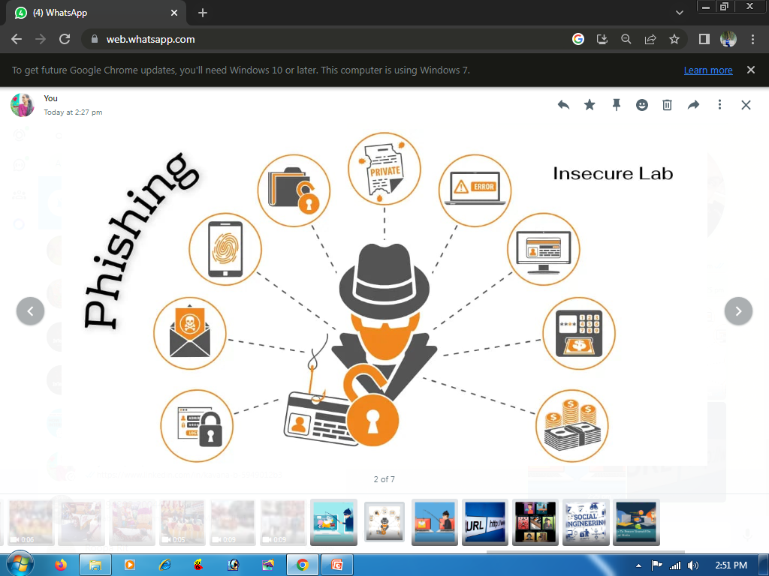
Types of Phishing Attacks
Email Phishing:
Deceptive emails that appears to be from legitimate sources
Spear phishing :
Targeted attacks on specific individuals or organizations
Whaling phishing:
Phishing attacks directed at high profile target
SMS phishing:
Fraudulent texts that trick users into revealing information.
Voice phishing:
Phone calls that impersonate legitimate entities.

Slide 4
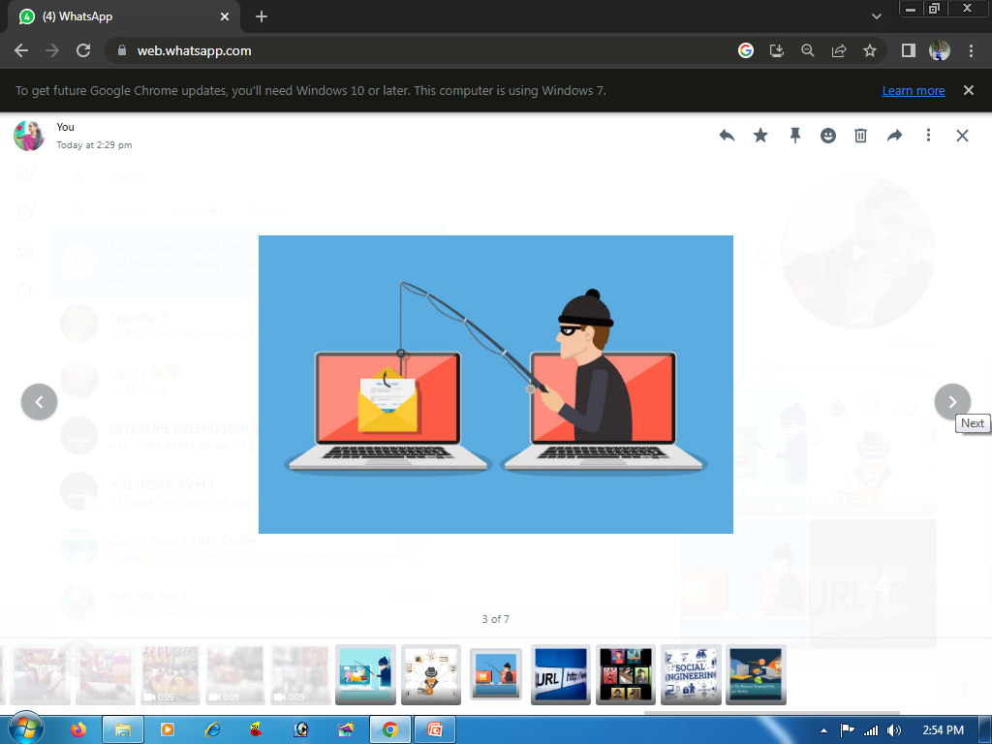
Recognizing Phishing Emails
Suspicious Sender Address:
Check for misspellings or unfamiliar domains
Generic Greetings:
Look for vague salutations like “Dear Customers”
Urgent Language :
Beware of threats or urgent requests to act quickly
Unusual Links:
Hover over links to see if they direct to legitimate sites.
Attachments:
Be cautious of unexpected attachments

Slide 5
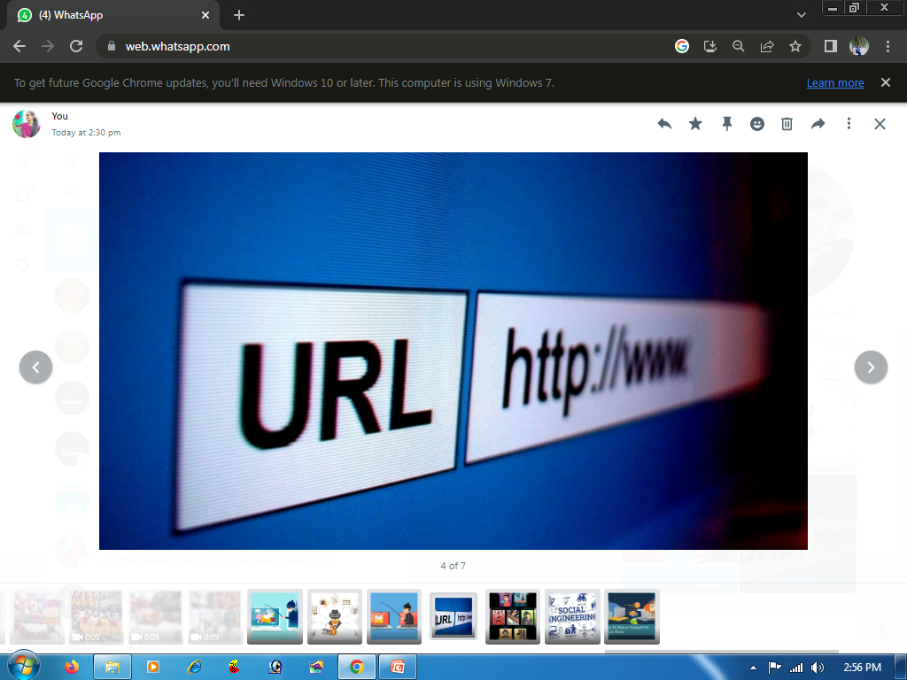
Spotting Fake Websites
Check the URL:
look for misspellings or unusual domain endings
Secure Connection:
Ensure the sites uses HTTPS , indicated by a padlock symbol
Design quality:
Poorly designed sites may indicate a scam
Contact information:
Verify the presence of legitimate contact details

Slide 6
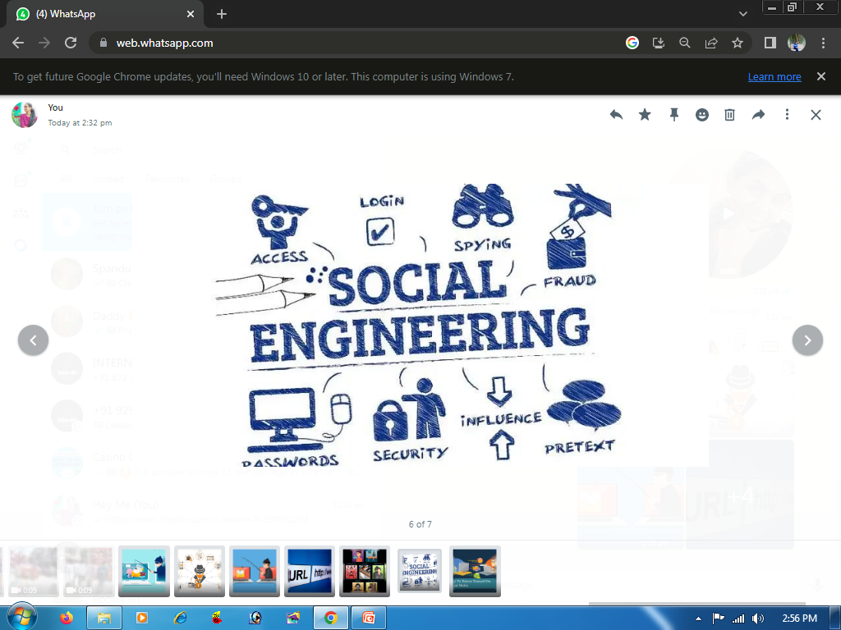
Social Engineering Techniques
Impersonation:
Attackers may pretend to be someone you trust
Information gathering:
Social media profiles can provide personal data for crafting convincing attacks
Psychological manipulation
Creating a sense of urgency or fear to provoke hasty decisions.

Slide 7
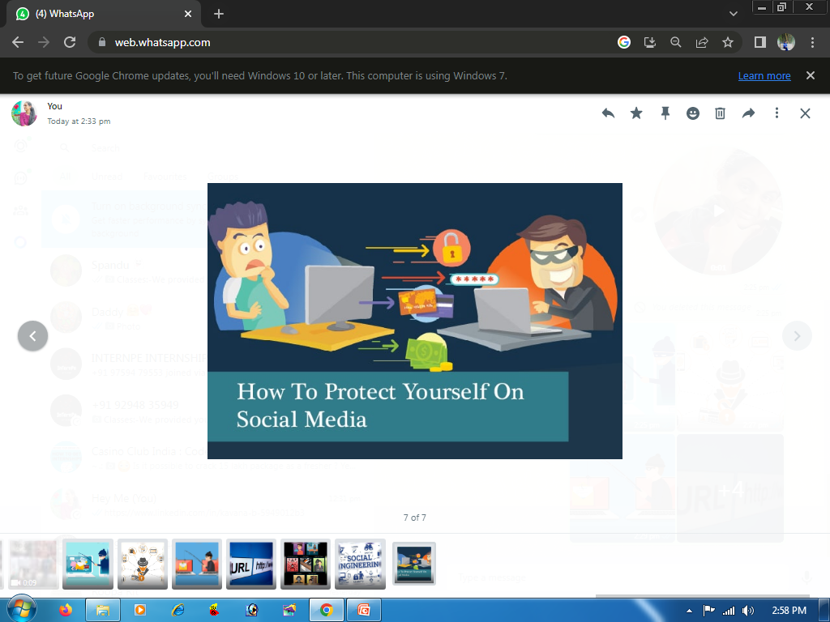
How To Protect Yourself
Verify requests:
Always confirm requests for sensitive information through a separate communication channel.
Educate Yourself:
Stay informed about the latest phishing techniques
Use Two-factors authentication:
Adds an extra layer of security to your accounts
Report Suspicious Activity:
Notify your IT departments or relevant authorities

Slide 8
Thank you

